Slide 1
Designing a Soldering Station
Brent Gerets

Slide 2
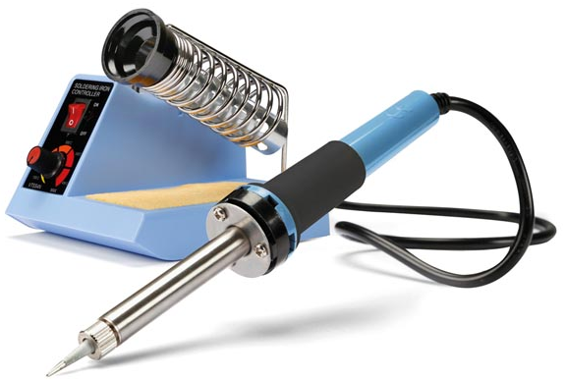
Introduction
Boring design
Looks like
dentist’s equipment
No personality

Slide 3
Goal
Boring design
Looks like
dentist’s equipment
No personality
Case with colours / decorations
Design own PCB
Unconventional case

Slide 4
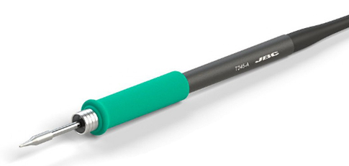
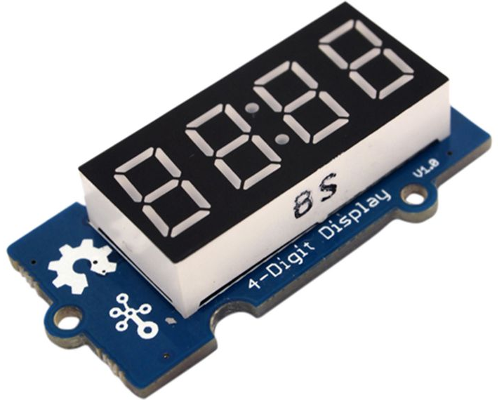
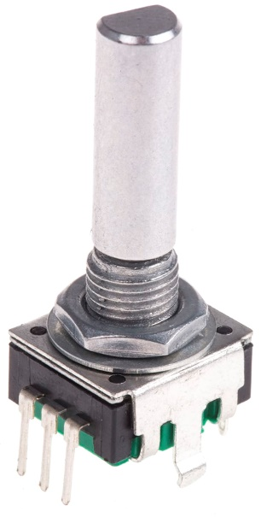
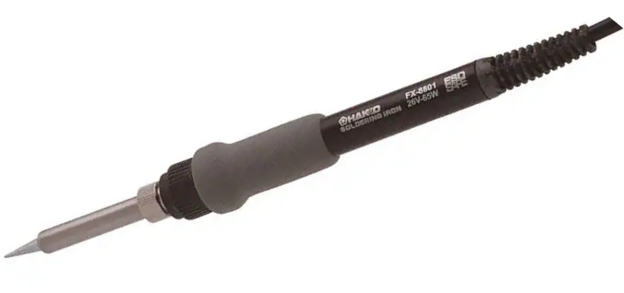
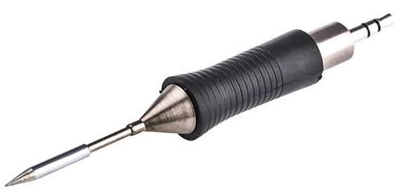
Result: Interactive Parts
Three different soldering irons
4-digit display
Rotary encoder with button

Slide 5

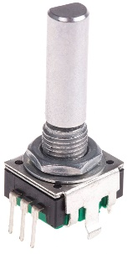

Result: Functionality
First use → configure soldering iron
Hold button
Turn on station
Rotate encoder
Hold button

Slide 6
Result: Functionality
First use → configure soldering iron
Hold button
Turn on station
Rotate encoder
Hold button
Setting temperature
Rotate encoder
Release encoder

Slide 7
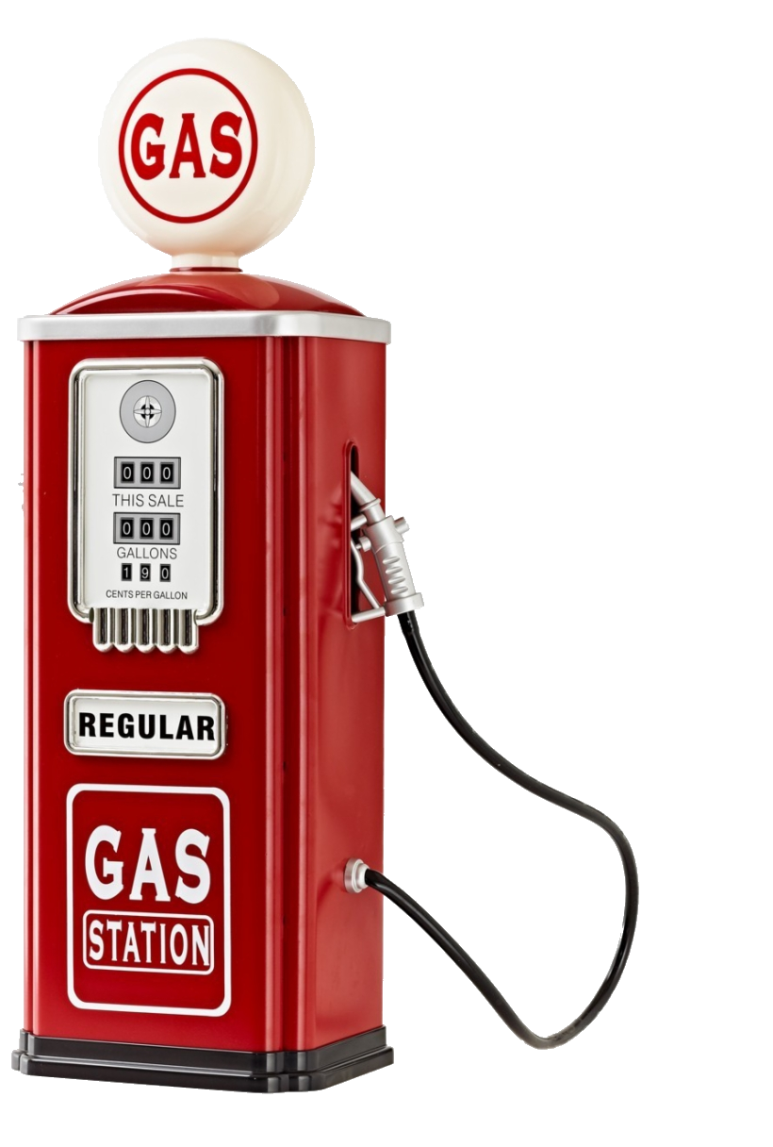
Result: Case Reference

Slide 8
Result: Case Reference
Rotary encoder
Personal preference
Incorporation
Not just a case
Display
Soldering iron

Slide 9
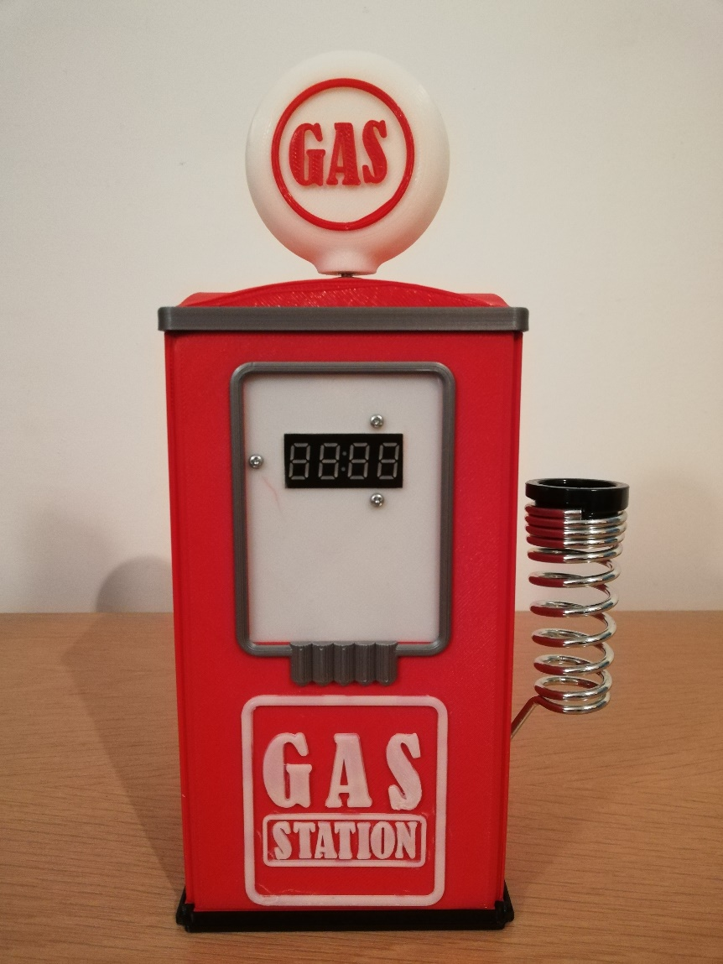
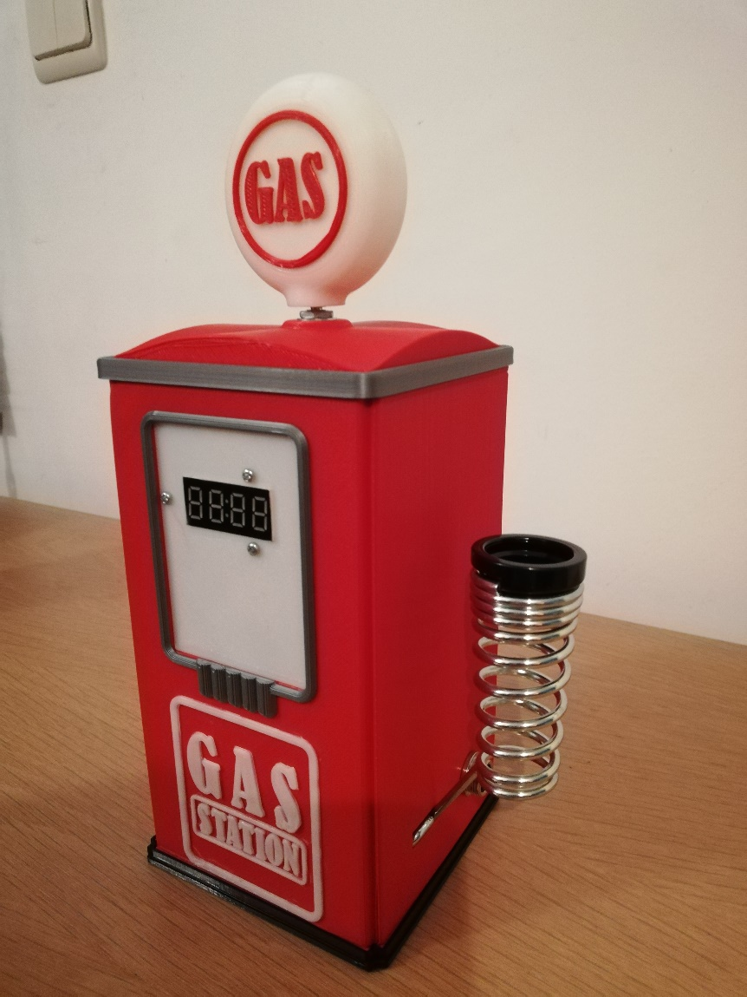
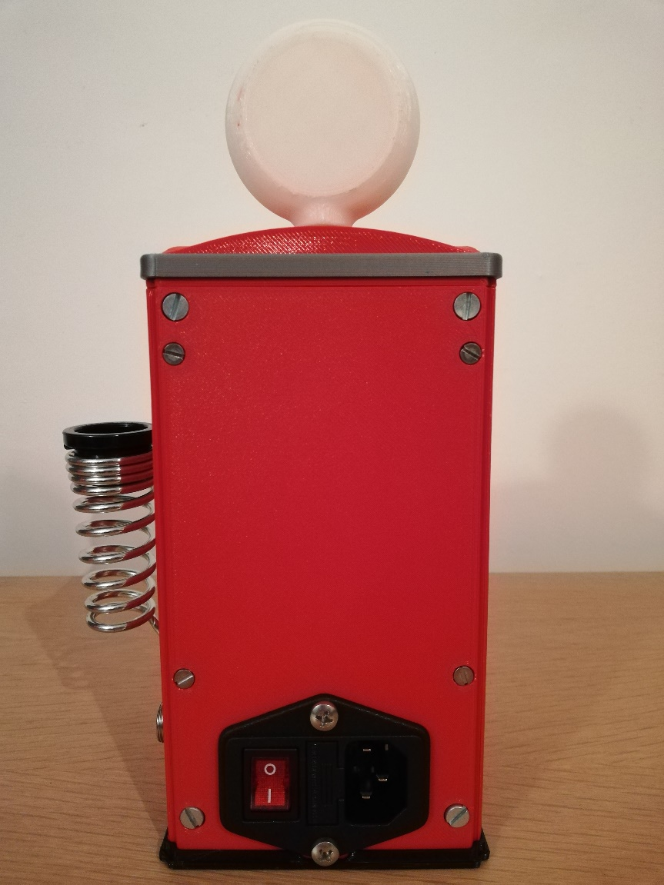
Result: Final Product

Slide 10
Discussion: Issues
Issue | Solution | Next time
Unavailable components | Order elsewhere | Order sooner
Incorrect footprints | Rewiring off of PCB | More checking
Lack of time | Crunching | Improved time management

Slide 11
Discussion: Experience / Lessons
PCB design
Difficult but rewarding
More care
Case design
Iterations necessary → start sooner
Pleased

Slide 12
Todo
Rewire relay
Test

Slide 13
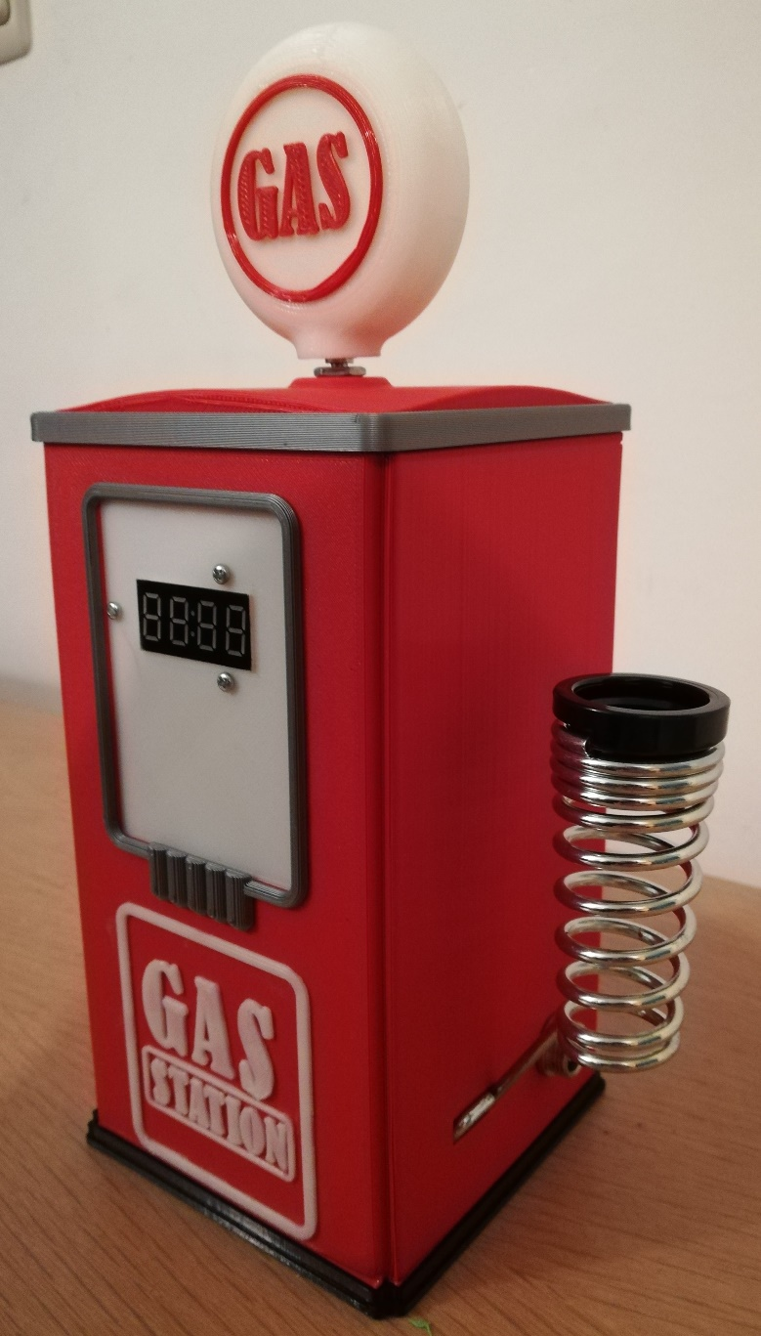
Questions

Slide 14
